Slide 1

Constraints
There are certain conditions for updating a VIEW. One of the following is not true about View update.
The SELECT statement which is used to create the view should not include GROUP BY clause or ORDER BY clause.
The SELECT statement should not have the DISTINCT keyword.
The View should have NULL values.
The view should not be created using nested queries or complex queries.
Unit -3

Slide 2
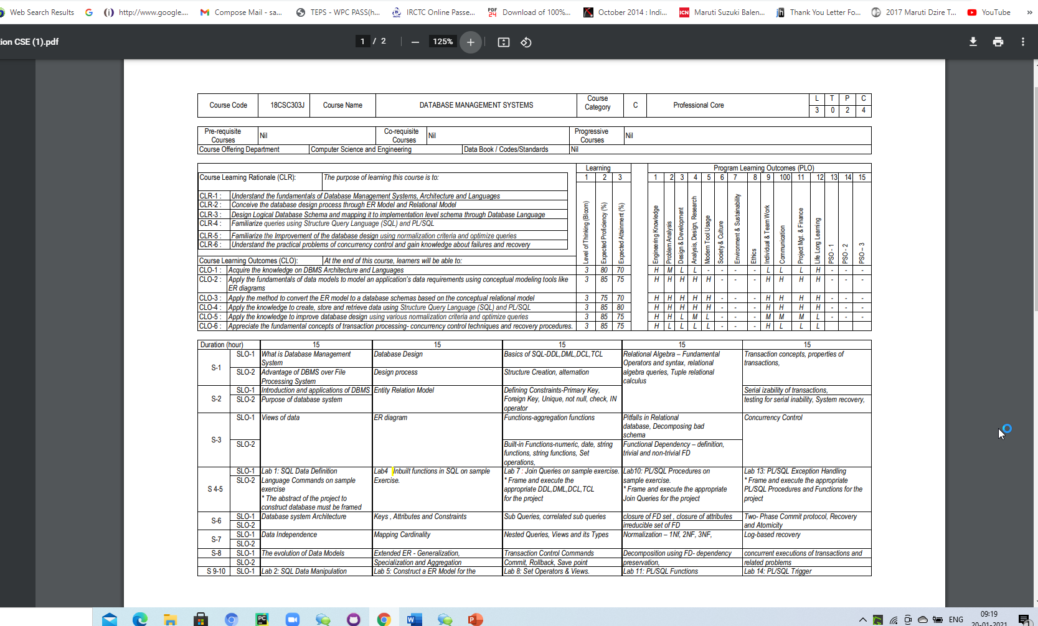

Slide 3
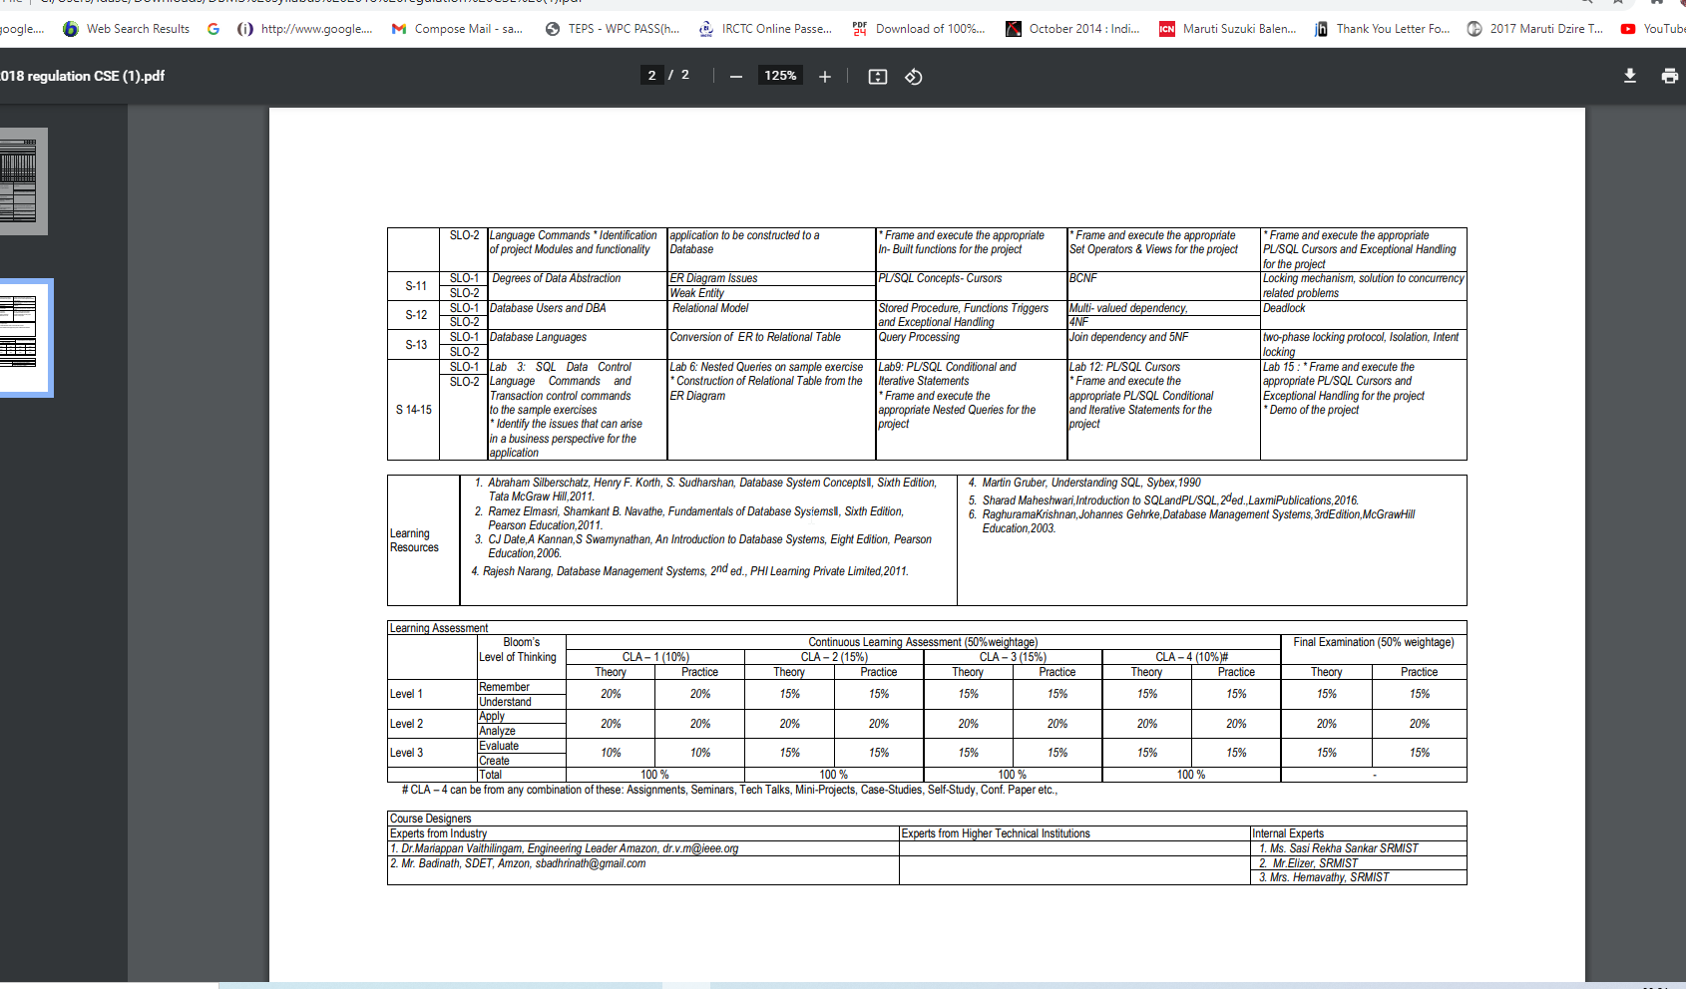

Slide 4
SQL Constraints
Constraints are the rules that we can apply on the type of data in a table. That is, we can specify the limit on the type of data that can be stored in a particular column in a table using constraints.
Constraints in SQL
Not Null
Unique
Primary Key
Foreign Key
Check
Default
How to specify constraints?
We can specify constraints at the time of creating the table using CREATE TABLE statement. We can also specify the constraints after creating a table using ALTER TABLE statement.

Slide 5
Syntax
CREATE TABLE sample_table(column1 data_type(size) constraint_name, column2 data_type(size) constraint_name, column3 data_type(size) constraint_name, .... );
sample_table: Name of the table to be created.
data_type: Type of data that can be stored in the field.
constraint_name: Name of the constraint. for example- NOT NULL, UNIQUE, PRIMARY KEY etc.

Slide 6
NOT NULL
If we specify a field in a table to be NOT NULL.
Then the field will never accept null value.
That is, you will be not allowed to insert a new row in the table without specifying any value to this field.
E.g.
CREATE TABLE Student ( ID int(6) NOT NULL, NAME varchar(10) NOT NULL, ADDRESS varchar(20) );

Slide 7
UNIQUE
This constraint helps to uniquely identify each row in the table. i.e. for a particular column, all the rows should have unique values. We can have more than one UNIQUE columns in a table.
E.g.
CREATE TABLE Student ( ID int(6) NOT NULL UNIQUE, NAME varchar(10), ADDRESS varchar(20) );

Slide 8
PRIMARY KEY
Primary Key is a field which uniquely identifies each row in the table.
If a field in a table as primary key, then the field will not be able to contain NULL values as well as all the rows should have unique values for this field.
In other words we can say that this is combination of NOT NULL and UNIQUE constraints.
A table can have only one field as primary key.
E.g.
CREATE TABLE Student ( ID int(6) NOT NULL UNIQUE, NAME varchar(10), ADDRESS varchar(20), PRIMARY KEY(ID) );

Slide 9
FOREIGN KEY
Foreign Key is a field in a table which uniquely identifies each row of a another table.
That is, this field points to primary key of another table. This usually creates a kind of link between the tables.
Foreign Key is used to relate two tables. The relationship between the two tables matches the Primary Key in one of the tables with a Foreign Key in the second table.
This is also called a referencing key.
We use ALTER statement and ADD statement to specify this constraint.

Slide 10
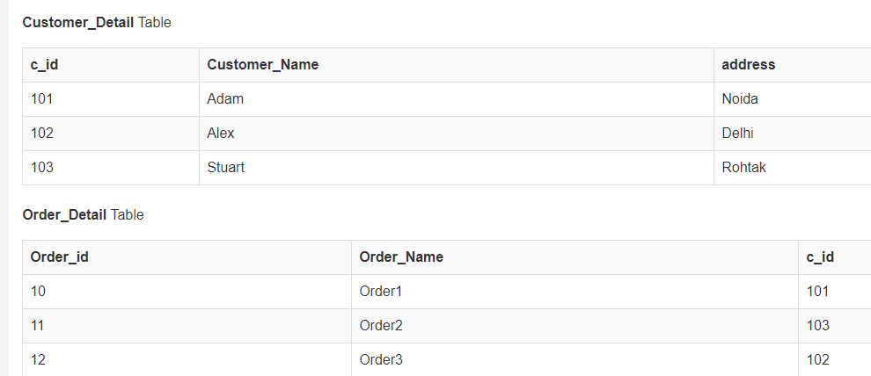

Slide 11
In Customer_Detail table, c_id is the primary key which is set as foreign key in Order_Detail table.
The value that is entered in c_id which is set as foreign key in Order_Detail table must be present in Customer_Detail table where it is set as primary key.
This prevents invalid data to be inserted into c_id column of Order_Detail table.
FOREIGN KEY constraint at Table Level
CREATE table Order_Detail( order_id int PRIMARY KEY, order_name varchar(60) NOT NULL, c_id int FOREIGN KEY REFERENCES Customer_Detail(c_id) );
FOREIGN KEY constraint at Column Level
ALTER table Order_Detail ADD FOREIGN KEY (c_id) REFERENCES Customer_Detail(c_id);

Slide 12
CHECK Constraint
CHECK constraint is used to restrict the value of a column between a range.
It performs check on the values, before storing them into the database.
It’s like condition checking before saving data into a column.
Using CHECK constraint at Table Level
CREATE table Student( s_id int NOT NULL CHECK(s_id > 0), Name varchar(60) NOT NULL, Age int );
Using CHECK constraint at Column Level
ALTER table Student ADD CHECK(s_id > 0);

Slide 13
DEFAULT
This constraint is used to provide a default value for the fields.
That is, if at the time of entering new records in the table if the user does not specify any value for these fields then the default value will be assigned to them.
E.g.
CREATE TABLE Student ( ID int(6) NOT NULL, NAME varchar(10) NOT NULL, AGE int DEFAULT 18 );

Slide 14
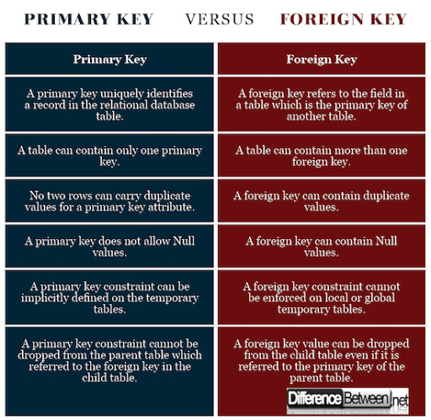
Primary Key Vs Foreign Key

Slide 15
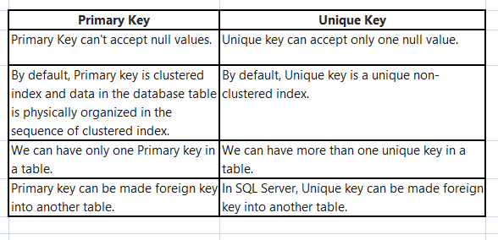
Primary Key Vs Unique Key

Slide 16
Aggregate functions in SQL
In database management an aggregate function is a function where the values of multiple rows are grouped together as input on certain criteria to form a single value of more significant meaning.
Various Aggregate Functions
Count()
Sum()
Avg()
Min()
Max()

Slide 17
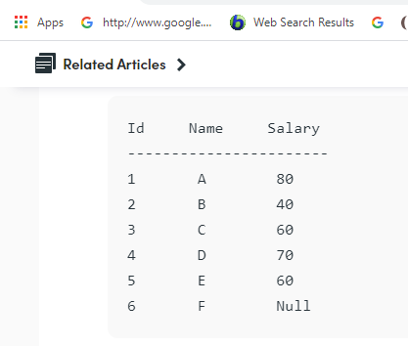
Count()
Count(*): Returns total number of records .i.e 6.
Count(salary): Return number of Non Null values over the column salary. i.e 5.
Count(Distinct Salary): Return number of distinct Non Null values over the column salary .i.e 4

Slide 18
Sum()
sum(salary): Sum all Non Null values of Column salary i.e., 310
sum(Distinct salary): Sum of all distinct Non-Null values i.e., 250.
Avg()
Avg(salary) = Sum(salary) / count(salary) = 310/5
Avg(Distinct salary) = sum(Distinct salary) / Count(Distinct Salary) = 250/4
Min(), Max()
Min(salary): Minimum value in the salary column except NULL i.e., 40.
Max(salary): Maximum value in the salary i.e., 80.

Slide 19
Built in Functions - Numeric Functions in SQL
ABS(): It returns the absolute value of a number.
Syntax: SELECT ABS(-243.5);
Output: 243.5
ACOS(): It returns the cosine of a number.
Syntax: SELECT ACOS(0.25);
Output: 1.318116071652818
ASIN(): It returns the arc sine of a number.
Syntax: SELECT ASIN(0.25);
Output: 0.25268025514207865
ATAN(): It returns the arc tangent of a number.
Syntax: SELECT ATAN(2.5);
Output: 1.1902899496825317
CEIL(): It returns the smallest integer value that is greater than or equal to a number.
Syntax: SELECT CEIL(25.75);
Output: 26
CEILING(): It returns the smallest integer value that is greater than or equal to a number.
Syntax: SELECT CEILING(25.75);
Output: 26
COS(): It returns the cosine of a number.
Syntax: SELECT COS(30);
Output: 0.15425144988758405

Slide 20
Built in Functions - Numeric Functions in SQL
COT(): It returns the cotangent of a number.
Syntax: SELECT COT(6);
Output: -3.436353004180128
DEGREES(): It converts a radian value into degrees.
Syntax: SELECT DEGREES(1.5);
Output: 85.94366926962348
DIV(): It is used for integer division.
Syntax: SELECT 10 DIV 5;
Output: 2
EXP(): It returns e raised to the power of number.
Syntax: SELECT EXP(1);
Output: 2.718281828459045
FLOOR(): It returns the largest integer value that is less than or equal to a number.
Syntax: SELECT FLOOR(25.75);
Output: 25
GREATEST(): It returns the greatest value in a list of expressions.
Syntax: SELECT GREATEST(30, 2, 36, 81, 125);
Output: 125
LEAST(): It returns the smallest value in a list of expressions.
Syntax: SELECT LEAST(30, 2, 36, 81, 125);
Output: 2
LN(): It returns the natural logarithm of a number.
Syntax: SELECT LN(2);
Output: 0.6931471805599453
LOG10(): It returns the base-10 logarithm of a number.
Syntax: SELECT LOG(2);
Output: 0.6931471805599453

Slide 21
Built in Functions - Numeric Functions in SQL
LOG2(): It returns the base-2 logarithm of a number.
Syntax: SELECT LOG2(6);
Output: 2.584962500721156
MOD(): It returns the remainder of n divided by m.
Syntax: SELECT MOD(18, 4);
Output: 2
PI(): It returns the value of PI displayed with 6 decimal places.
Syntax: SELECT PI();
Output: 3.141593
POW(): It returns m raised to the nth power.
Syntax: SELECT POW(4, 2);
Output: 16
RADIANS(): It converts a value in degrees to radians.
Syntax: SELECT RADIANS(180);
RAND(): It returns a random number.
Syntax: SELECT RAND();
Output: 0.33623238684258644
ROUND(): It returns a number rounded to a certain number of decimal places.
Syntax: SELECT ROUND(5.553);
Output: 6
SIGN(): It returns a value indicating the sign of a number.
Syntax: SELECT SIGN(255.5);
Output: 1
SIN(): It returns the sine of a number.
Syntax: SELECT SIN(2);
Output: 0.9092974268256817

Slide 22
Built in Functions - Numeric Functions in SQL
SQRT(): It returns the square root of a number.
Syntax: SELECT SQRT(25);
Output: 5
TAN(): It returns the tangent of a number.
Syntax: SELECT TAN(1.75);
Output: -5.52037992250933
ATAN2(): It returns the arctangent of the x and y coordinates, as an angle and expressed in radians.
Syntax: SELECT ATAN2(7);
Output: 1.42889927219073
TRUNCATE(): This doesn’t work for SQL Server. It returns 7.53635 truncated to 2 places right of the decimal point.
Syntax: SELECT TRUNCATE(7.53635, 2);
Output: 7.53

Slide 23
Built in Functions - String functions in SQL
ASCII(): This function is used to find the ASCII value of a character.
Syntax: SELECT ascii('t’);
Output: 116
CHAR_LENGTH(): Doesn’t work for SQL Server. Use LEN() for SQL Server. This function is used to find the length of a word.
Syntax: SELECT char_length('Hello!’);
Output: 6
CHARACTER_LENGTH(): Doesn’t work for SQL Server. Use LEN() for SQL Server. This function is used to find the length of a line.
Syntax: SELECT CHARACTER_LENGTH('geeks for geeks’);
Output: 15
CONCAT(): This function is used to add two words or strings.
Syntax: SELECT 'Geeks' || ' ' || 'forGeeks';
Output: ‘GeeksforGeeks’
CONCAT_WS(): This function is used to add two words or strings with a symbol as concatenating symbol.
Syntax: SELECT CONCAT_WS('_', 'geeks', 'for', 'geeks’);
Output: geeks_for_geeks
FIND_IN_SET(): This function is used to find a symbol from a set of symbols.
Syntax: SELECT FIND_IN_SET('b', 'a, b, c, d, e, f’);
Output: 2
FORMAT(): This function is used to display a number in the given format.
Syntax: Format("0.981", "Percent");
Output: ‘98.10%’

Slide 24
Built in Functions - String functions in SQL
INSTR(): This function is used to find the occurrence of an alphabet.
Syntax: INSTR('geeks for geeks', 'e’);
Output: 2 (the first occurrence of ‘e’)
Syntax: INSTR('geeks for geeks', 'e', 1, 2 );
Output: 3 (the second occurrence of ‘e’)
LCASE(): This function is used to convert the given string into lower case.
Syntax: LCASE ("GeeksFor Geeks To Learn");
Output: geeksforgeeks to learn
LEFT(): This function is used to SELECT a sub string from the left of given size or characters.
Syntax: SELECT LEFT('geeksforgeeks.org', 5);
Output: geeks
LENGTH(): This function is used to find the length of a word.
Syntax: LENGTH('GeeksForGeeks’);
Output: 13
LOCATE(): This function is used to find the nth position of the given word in a string.
Syntax: SELECT LOCATE('for', 'geeksforgeeks', 1);
Output: 6
LOWER(): This function is used to convert the upper case string into lower case.
Syntax: SELECT LOWER('GEEKSFORGEEKS.ORG’);
Output: geeksforgeeks.org
LPAD(): This function is used to make the given string of the given size by adding the given symbol.
Syntax: LPAD('geeks', 8, '0’);
Output: 000geeks

Slide 25
Built in Functions - String functions in SQL
LTRIM(): This function is used to cut the given sub string from the original string.
Syntax: LTRIM('123123geeks', '123’);
Output: geeks
MID(): This function is to find a word from the given position and of the given size.
Syntax: Mid ("geeksforgeeks", 6, 2);
Output: for
POSITION(): This function is used to find position of the first occurrence of the given alphabet.
Syntax: SELECT POSITION('e' IN 'geeksforgeeks’);
Output: 2
REPEAT(): This function is used to write the given string again and again till the number of times mentioned.
Syntax: SELECT REPEAT('geeks', 2);
Output: geeksgeeks
REPLACE(): This function is used to cut the given string by removing the given sub string.
Syntax: REPLACE('123geeks123', '123’);
Output: geeks
REVERSE(): This function is used to reverse a string.
Syntax: SELECT REVERSE('geeksforgeeks.org’);
Output: ‘gro.skeegrofskeeg’
RIGHT(): This function is used to SELECT a sub string from the right end of the given size.
Syntax: SELECT RIGHT('geeksforgeeks.org', 4);
Output: ‘.org’
RPAD(): This function is used to make the given string as long as the given size by adding the given symbol on the right.
Syntax: RPAD('geeks', 8, '0’);
Output: ‘geeks000’
RTRIM(): This function is used to cut the given sub string from the original string.
Syntax: RTRIM('geeksxyxzyyy', 'xyz’);
Output: ‘geeks’
SPACE(): This function is used to write the given number of spaces.
Syntax: SELECT SPACE(7);
Output: ‘ ‘

Slide 26
Built in Functions - String functions in SQL
STRCMP(): This function is used to compare 2 strings.
If string1 and string2 are the same, the STRCMP function will return 0.
If string1 is smaller than string2, the STRCMP function will return -1.
If string1 is larger than string2, the STRCMP function will return 1.
Syntax: SELECT STRCMP('google.com', 'geeksforgeeks.com’);
Output: -1
SUBSTR(): This function is used to find a sub string from the a string from the given position.
Syntax:SUBSTR('geeksforgeeks', 1, 5);
Output: ‘geeks’
SUBSTRING(): This function is used to find an alphabet from the mentioned size and the given string.
Syntax: SELECT SUBSTRING('GeeksForGeeks.org', 9, 1);
Output: ‘G’
SUBSTRING_INDEX(): This function is used to find a sub string before the given symbol.
Syntax: SELECT SUBSTRING_INDEX('www.geeksforgeeks.org', '.', 1);
Output: ‘www’
TRIM(): This function is used to cut the given symbol from the string.
Syntax: TRIM(LEADING '0' FROM '000123’);
Output: 123
UCASE(): This function is used to make the string in upper case.
Syntax: UCASE ("GeeksForGeeks");
Output: GEEKSFORGEEKS

Slide 27
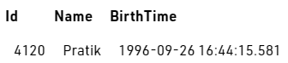
Built in Functions - Date functions in SQL
NOW(): Returns the current date and time.
Example: SELECT NOW();
Output:2017-01-13 08:03:52
CURDATE(): Returns the current date.
Example: SELECT CURDATE();
Output: 2017-01-13
CURTIME(): Returns the current time.
Example: SELECT CURTIME();
Output: 08:05:15
DATE(): Extracts the date part of a date or date/time expression.
EXTRACT(): Returns a single part of a date/time.
Syntax: EXTRACT(unit FORM date);
SELECT Name, Extract(DAY FROM BirthTime) AS BirthDay FROM Test;
Output:
Name | BirthDay
Pratik | 26

Slide 28
Built in Functions - Date functions in SQL
DATE_ADD() : Adds a specified time interval to a date
Syntax: DATE_ADD(date, INTERVAL expr type);
SELECT Name, DATE_ADD(BirthTime, INTERVAL 1 YEAR) AS BirthTimeModified FROM Test;
Output:
DATE_SUB(): Subtracts a specified time interval from a date. Syntax for DATE_SUB is same as DATE_ADD just the difference is that DATE_SUB is used to subtract a given interval of date.
DATEDIFF(): Returns the number of days between two dates.
Syntax: DATEDIFF(date1, date2); date1 & date2- date/time expression
SELECT DATEDIFF('2017-01-13','2017-01-03') AS DateDiff;
Output:10
Name | BirthTimeModified
Pratik | 1997-09-26 16:44:15.581

Slide 29
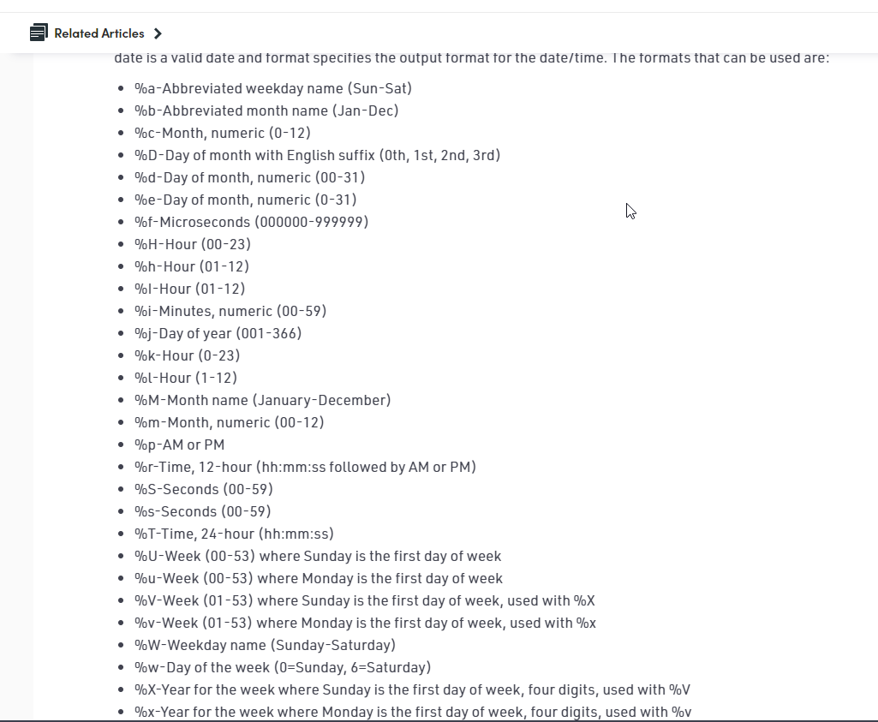
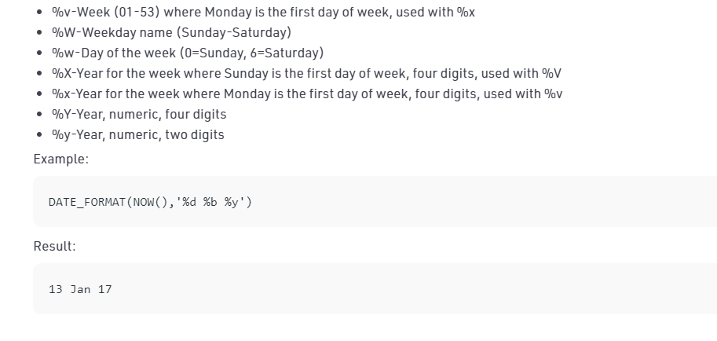
Built in Functions - Date functions in SQL
DATE_FORMAT(): Displays date/time data in different formats.
Syntax: DATE_FORMAT(date,format);

Slide 30
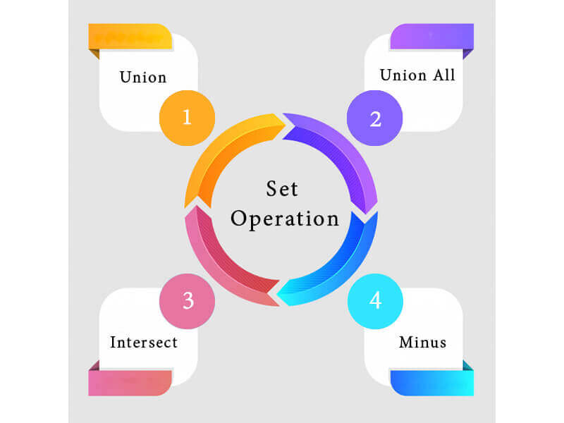
Set Operation functions in SQL
The SQL Set operation is used to combine the two or more SQL SELECT statements.
Types of Set Operation

Slide 31
UNION Operation
UNION is used to combine the results of two or more SELECT statements.
However it will eliminate duplicate rows from its result set.
In case of union, number of columns and datatype must be same in both the tables, on which UNION operation is being applied.

Slide 32
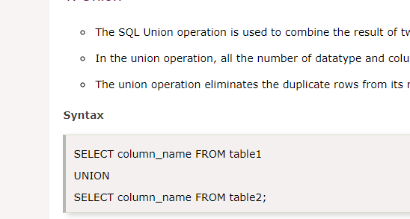
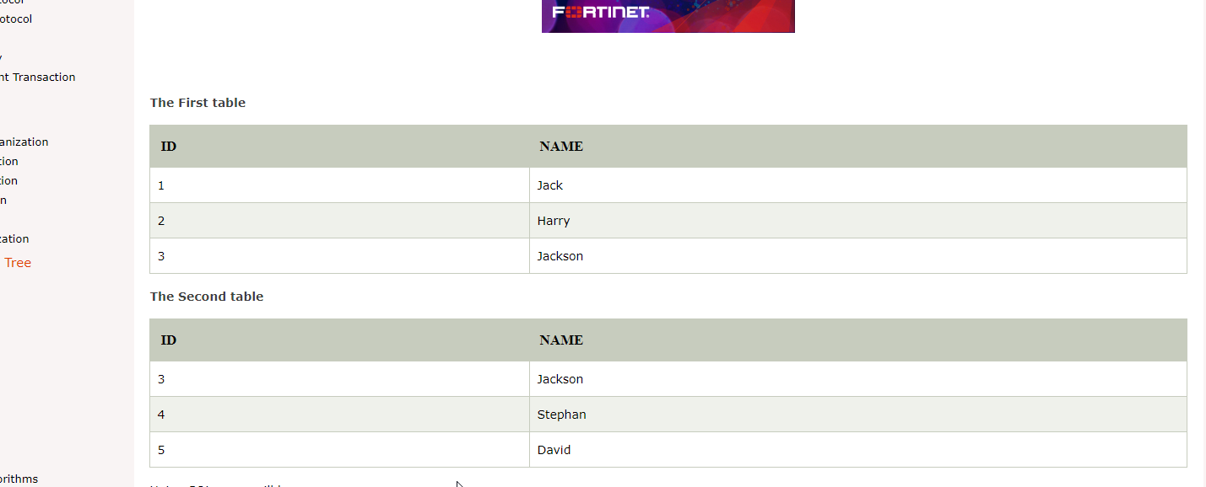
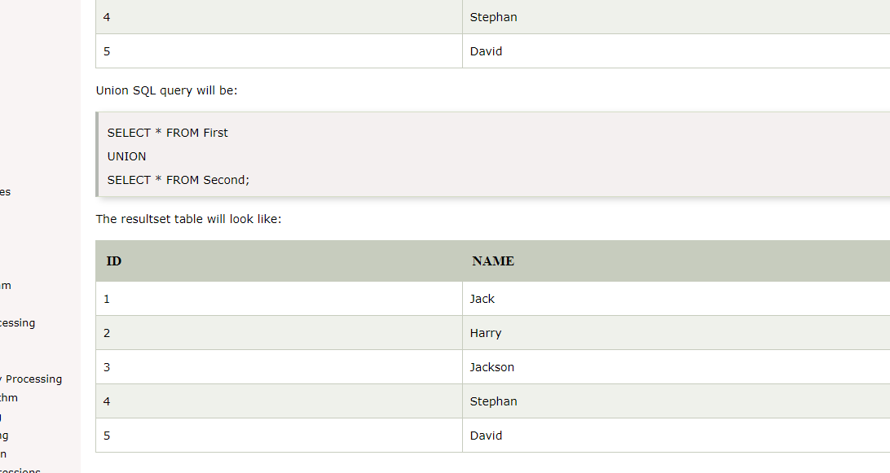

Slide 33
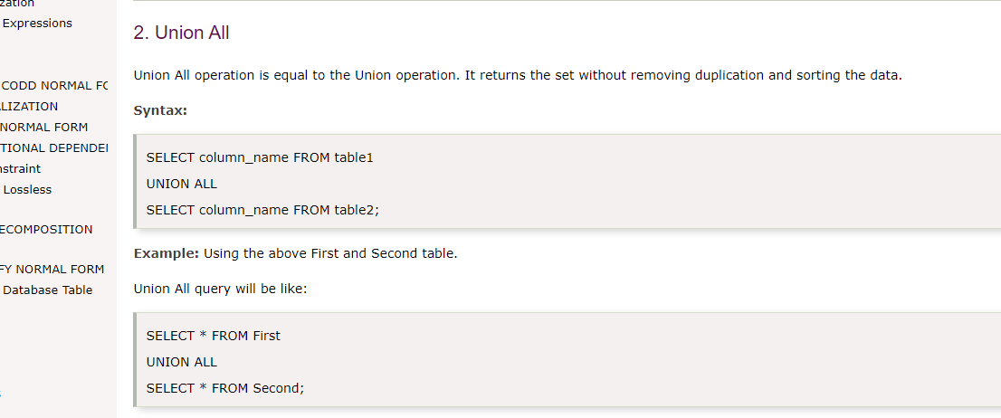
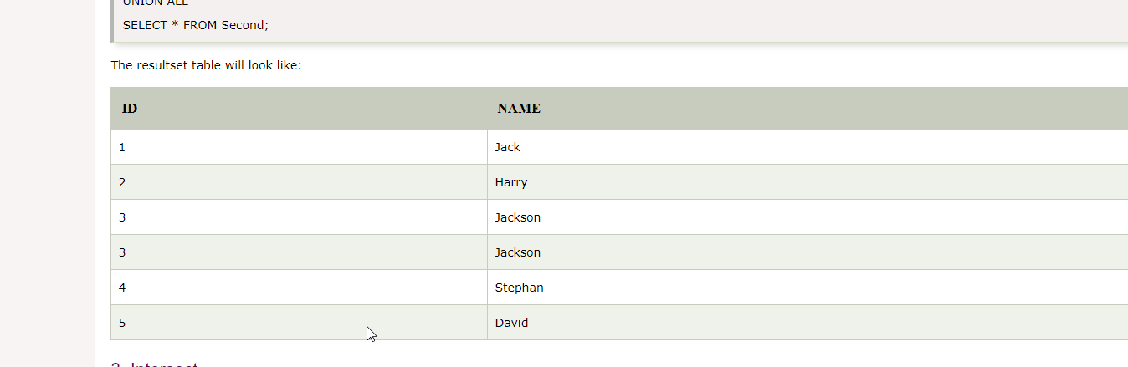
Union All
Union All operation is equal to the Union operation. It returns the set without removing duplication and sorting the data.

Slide 34
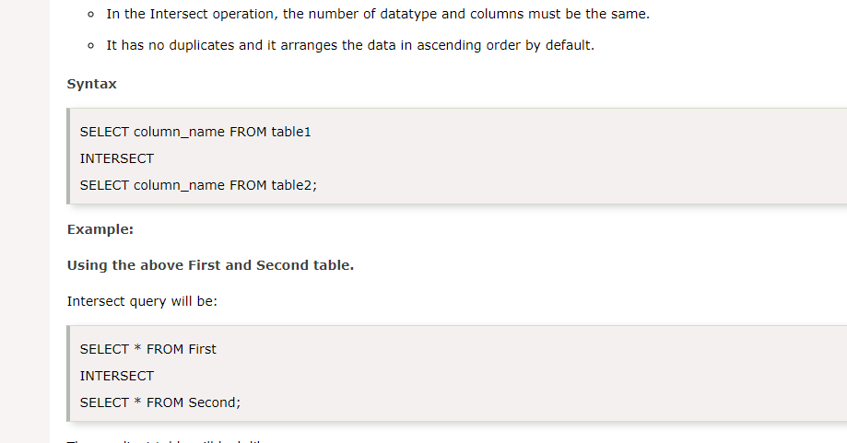
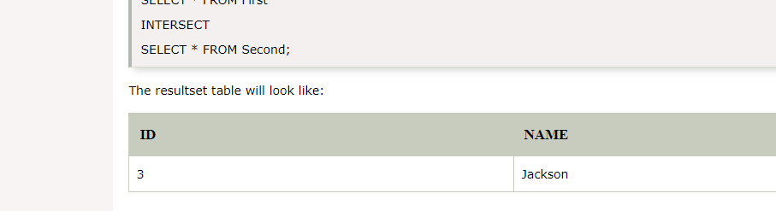
Intersect
It is used to combine two SELECT statements. The Intersect operation returns the common rows from both the SELECT statements.
In the Intersect operation, the number of datatype and columns must be the same.
It has no duplicates and it arranges the data in ascending order by default.

Slide 35
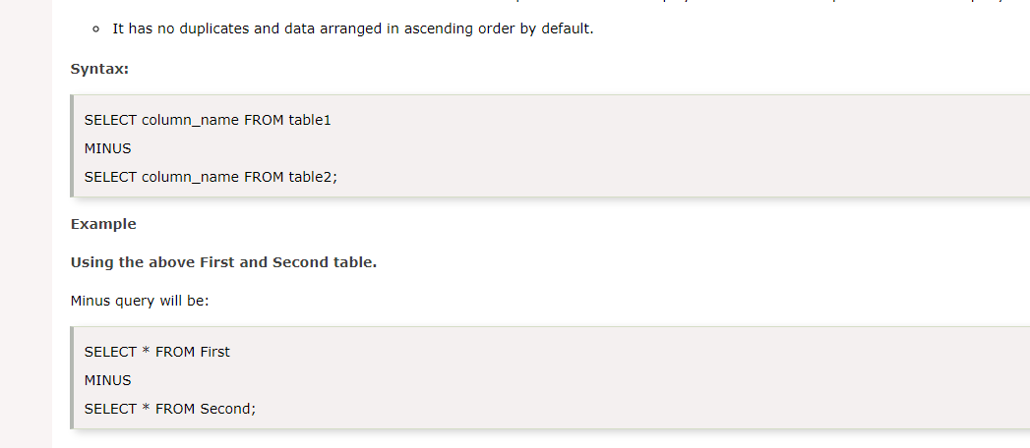
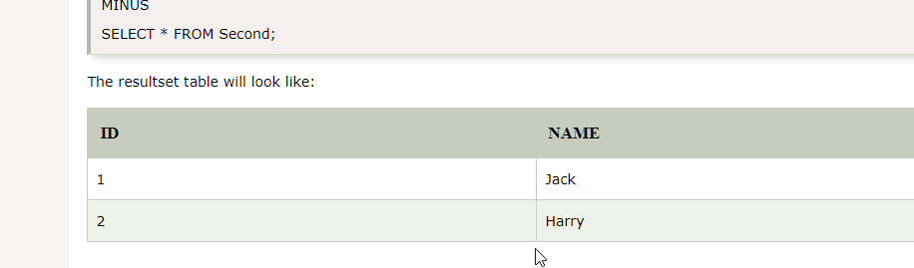
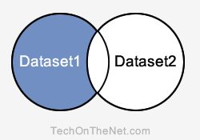
Minus
It combines the result of two SELECT statements. Minus operator is used to display the rows which are present in the first query but absent in the second query.
It has no duplicates and data arranged in ascending order by default.
SELECT supplier_id
FROM suppliers
MINUS
SELECT supplier_id
FROM orders;

Slide 36
Subquery
Subquery can be simply defined as a query within another query. In other words we can say that a Subquery is a query that is embedded in WHERE clause of another SQL query.
Important rules for Subqueries
You can place the Subquery in a number of SQL clauses: WHERE clause, HAVING clause, FROM clause.
Subqueries can be used with SELECT, UPDATE, INSERT, DELETE statements along with expression operator. It could be equality operator or comparison operator such as =, >, =, <= and Like operator.
A subquery is a query within another query. The outer query is called as main query and inner query is called as subquery.
The subquery generally executes first, and its output is used to complete the query condition for the main or outer query.
Subquery must be enclosed in parentheses.
Subqueries are on the right side of the comparison operator.
ORDER BY command cannot be used in a Subquery. GROUPBY command can be used to perform same function as ORDER BY command.
Use single-row operators with singlerow Subqueries. Use multiple-row operators with multiple-row Subqueries.

Slide 37
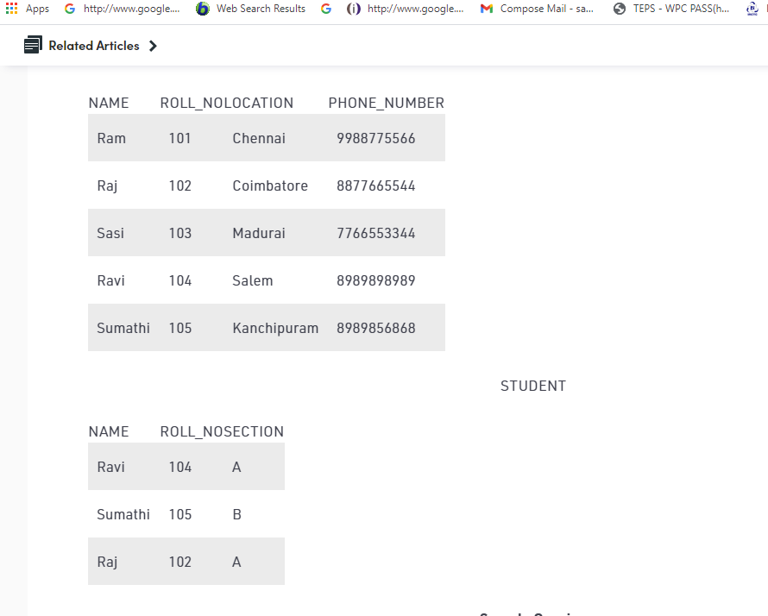
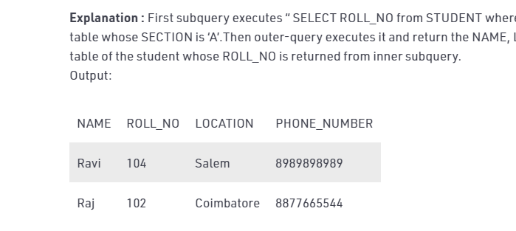
Subqueries with SELECT statement
Syntax
SELECT column_name FROM table_name WHERE column_name expression operator ( SELECT COLUMN_NAME from TABLE_NAME WHERE ... );
Select NAME, LOCATION, PHONE_NUMBER from DATABASE WHERE ROLL_NO IN (SELECT ROLL_NO from STUDENT where SECTION=’A’);

Slide 38
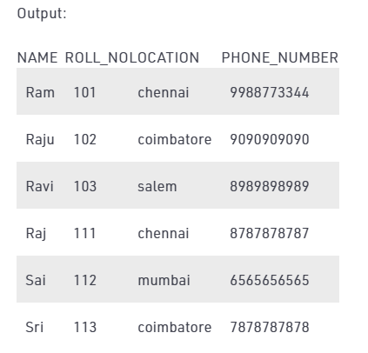
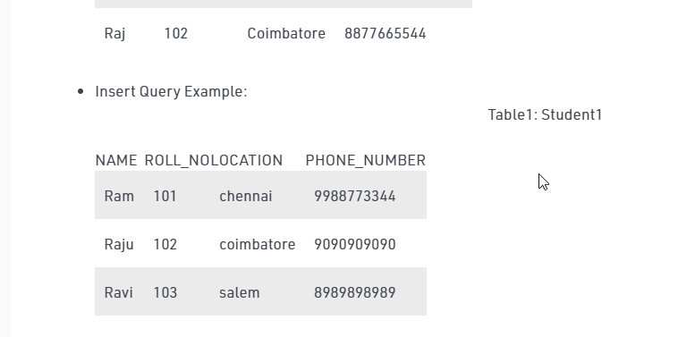
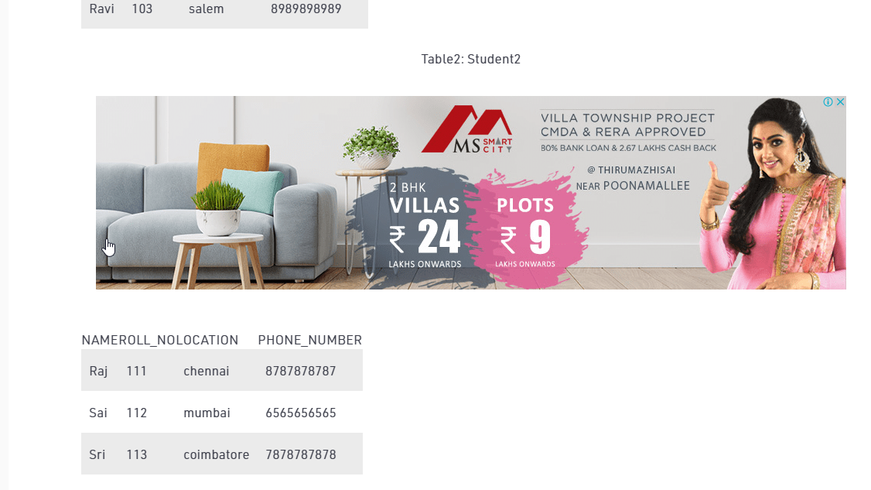
Subqueries with the INSERT Statement
Subqueries also can be used with INSERT statements.
The INSERT statement uses the data returned from the subquery to insert into another table.
The selected data in the subquery can be modified with any of the character, date or number functions.
INSERT INTO Student1 (SELECT * FROM Student2);

Slide 39
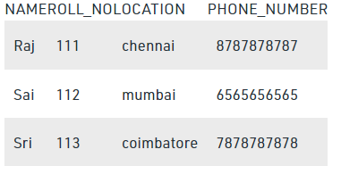
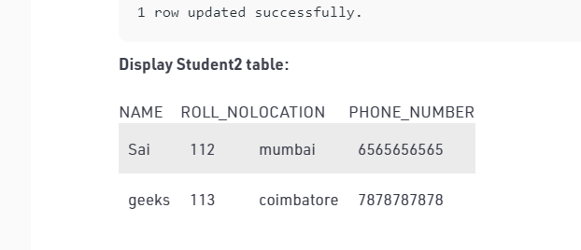
Subqueries with the UPDATE Statement
The subquery can be used in conjunction with the UPDATE statement. Either single or multiple columns in a table can be updated when using a subquery with the UPDATE statement.
To update name of the students to geeks in Student2 table whose location is same as Raju,Ravi in Student1 table
UPDATE Student2 SET NAME=’geeks’ WHERE LOCATION IN ( SELECT LOCATION FROM Student1 WHERE NAME IN (‘Raju’,’Ravi’));

Slide 40
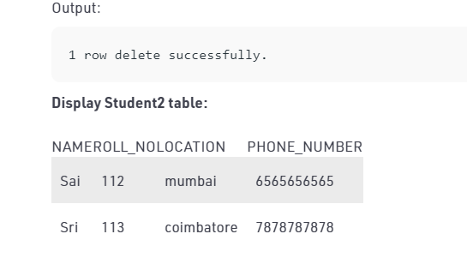
Subqueries with the DELETE Statement
The subquery can be used in conjunction with the DELETE statement like with any other statements mentioned above.
To delete students from Student2 table whose rollno is same as that in Student1 table and having location as Chennai.

Slide 41
DELETE FROM Student2 WHERE ROLL_NO IN ( SELECT ROLL_NO FROM Student1 WHERE LOCATION = ‘chennai’);

Slide 42
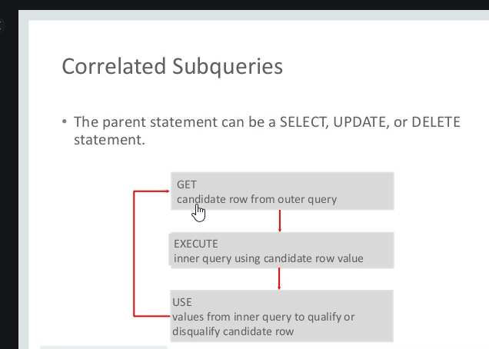
SQL Correlated Subqueries
Correlated subqueries are used for row-by-row processing. Each subquery is executed once for every row of the outer query.
A correlated subquery is evaluated once for each row processed by the parent statement. The parent statement can be a SELECT, UPDATE, or DELETE statement.
A correlated subquery is one way of reading every row in a table and comparing values in each row against related data.
It is used whenever a subquery must return a different result or set of results for each candidate row considered by the main query.

Slide 43
Nested Subqueries Versus Correlated Subqueries
With a normal nested subquery, the inner SELECT query runs first and executes once, returning values to be used by the main query.
A correlated subquery, however, executes once for each candidate row considered by the outer query.
In other words, the inner query is driven by the outer query.
NOTE : You can also use the ANY and ALL operator in a correlated subquery.

Slide 44
A correlated subquery is evaluated once for each row processed by the parent statement. The parent statement can be a SELECT, UPDATE, or DELETE statement.
SELECT column1, column2, ....
FROM table1 outer
WHERE column1 operator
(SELECT column1, column2
FROM table2
WHERE expr1 =
outer.expr2);

Slide 45
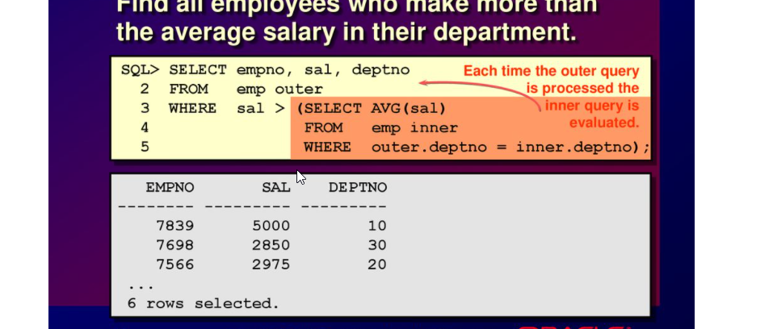
Correlated Subqueries with Select Statement
Find all the employees who earn more than the average salary
in their department.

Slide 46
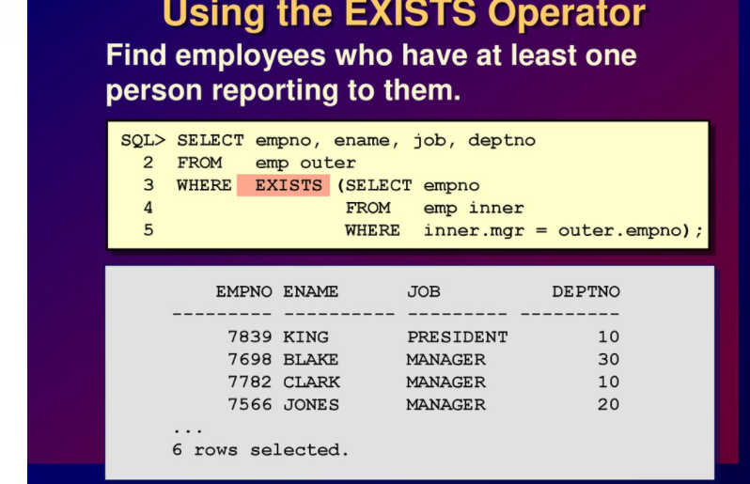
Using the Exists Operator
The EXISTS operator tests for existence of rows in the results set of the subquery.
If a subquery row value is found the condition is flagged TRUE and the search does not continue in the inner query, and if it is not found then the condition is flagged FALSE and the search continues in the inner query.
Find the employees who have at least one person reporting to them.

Slide 47
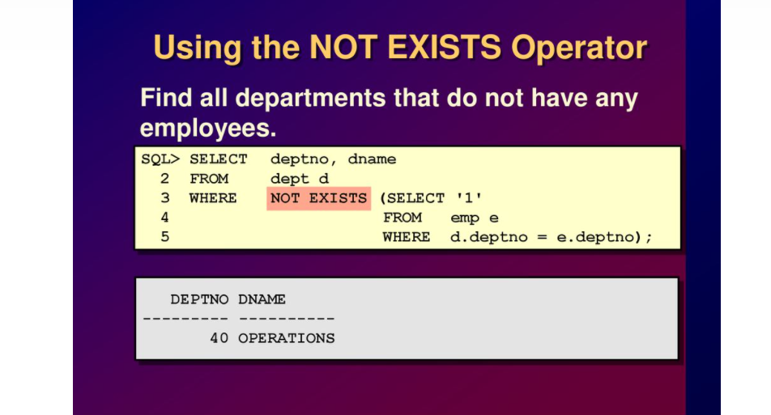
Using the Not Exists Operator
Find all the departments that do not have any employees

Slide 48
CORRELATED UPDATE & DELETE
CORRELATED UPDATE
UPDATE table1 alias1 SET column = (SELECT expression FROM table2 alias2 WHERE alias1.column = alias2.column);
Use a correlated subquery to update rows in one table based on rows from another table.
CORRELATED DELETE
DELETE FROM table1 alias1 WHERE column1 operator (SELECT expression FROM table2 alias2 WHERE alias1.column = alias2.column);
Use a correlated subquery to delete rows in one table based on the rows from another table.

Slide 49
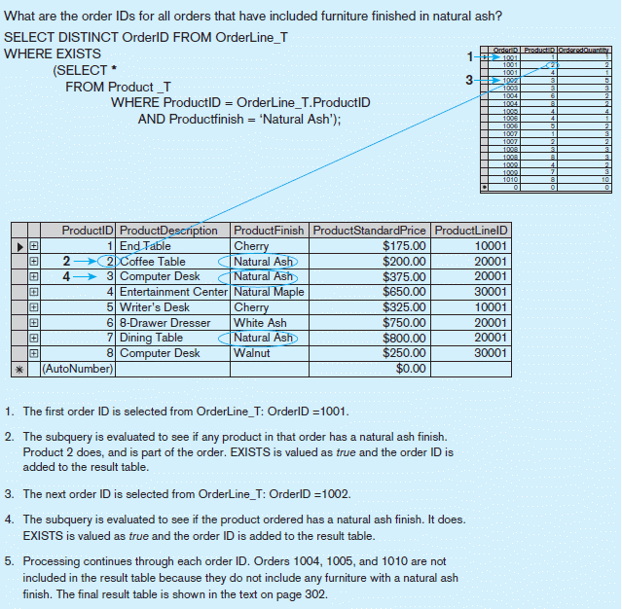
Processing a correlated subquery Using the Exists Operator - E.g.

Slide 50
Note: Only the orders that involve products with Natural Ash will be included in the final results.

Slide 51
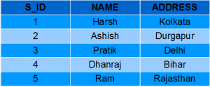
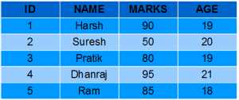
SQL Views
Views in SQL are kind of virtual tables.
A view also has rows and columns as they are in a real table in the database.
We can create a view by selecting fields from one or more tables present in the database.
A View can either have all the rows of a table or specific rows based on certain condition.
Student Marks
Student Details

Slide 52
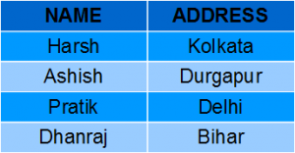
Creating a View
Student Details
View can be created using CREATE VIEW statement. A View can be created from a single table or multiple tables.
Syntax
CREATE VIEW view_name AS SELECT column1, column2..... FROM table_name WHERE condition;
view_name: Name for the View
table_name: Name of the table
condition: Condition to select rows
Creating View from a single table
CREATE VIEW DetailsView AS SELECT NAME, ADDRESS FROM StudentDetails WHERE S_ID < 5;
To see the data in the View, we can query the view in the same manner as we query a table.
SELECT * FROM DetailsView;
Output

Slide 53
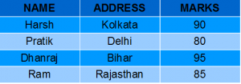
Student Details
Creating View from multiple tables
In this example we will create a View named MarksView from two tables StudentDetails and StudentMarks.
To create a View from multiple tables we can simply include multiple tables in the SELECT statement.
CREATE VIEW MarksView AS SELECT StudentDetails.NAME, StudentDetails.ADDRESS, StudentMarks.MARKS FROM StudentDetails, StudentMarks WHERE StudentDetails.NAME = StudentMarks.NAME;
To display data of View MarksView:
SELECT * FROM MarksView;
Student Marks
Output

Slide 54
DELETING VIEWS
SQL allows us to delete an existing View.
We can delete or drop a View using the DROP statement.
Syntax
DROP VIEW view_name;
view_name: Name of the View which we want to delete.
For example, if we want to delete the View MarksView.
DROP VIEW MarksView;

Slide 55
UPDATING VIEWS
There are certain conditions needed to be satisfied to update a view. If any one of these conditions is not met, then we will not be allowed to update the view.
The SELECT statement which is used to create the view should not include GROUP BY clause or ORDER BY clause.
The SELECT statement should not have the DISTINCT keyword.
The View should have all NOT NULL values.
The view should not be created using nested queries or complex queries.
The view should be created from a single table. If the view is created using multiple tables then we will not be allowed to update the view.

Slide 56
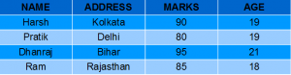
CREATE OR REPLACE VIEW
We can use the CREATE OR REPLACE VIEW statement to add or remove fields from a view.
Syntax
CREATE OR REPLACE VIEW view_name AS SELECT column1,coulmn2,.. FROM table_name WHERE condition;
For example, if we want to update the view MarksView and add the field AGE to this View from StudentMarks Table, we can do this as:
CREATE OR REPLACE VIEW MarksView AS SELECT StudentDetails.NAME, StudentDetails.ADDRESS, StudentMarks.MARKS, StudentMarks.AGE FROM StudentDetails, StudentMarks WHERE StudentDetails.NAME = StudentMarks.NAME;
If we fetch all the data from MarksView now as:
SELECT * FROM MarksView;
Output

Slide 57
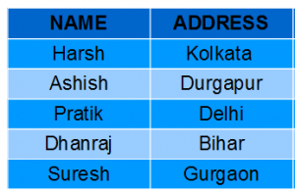
Inserting a row in a view
We can insert a row in a View in a same way as we do in a table. We can use the INSERT INTO statement of SQL to insert a row in a View.
Syntax:
INSERT INTO view_name(column1, column2 , column3,..) VALUES(value1, value2, value3..); view_name: Name of the View
Example: In the below example we will insert a new row in the View DetailsView which we have created above in the example of “creating views from a single table”.
INSERT INTO DetailsView(NAME, ADDRESS) VALUES("Suresh","Gurgaon");
If we fetch all the data from DetailsView now as,
SELECT * FROM DetailsView;
Output

Slide 58
Deleting a row from a View
Deleting rows from a view is also as simple as deleting rows from a table.
We can use the DELETE statement of SQL to delete rows from a view.
Also deleting a row from a view first delete the row from the actual table and the change is then reflected in the view.
Syntax
DELETE FROM view_name WHERE condition;
view_name:Name of view from where we want to delete rows
condition: Condition to select rows
In this example we will delete the last row from the view DetailsView which we just added in the above example of inserting rows.
DELETE FROM DetailsView WHERE NAME="Suresh";
If we fetch all the data from DetailsView now as,
SELECT * FROM DetailsView;
Output

Slide 59
Uses of a View
Restricting data access Views provide an additional level of table security by restricting access to a predetermined set of rows and columns of a table.
Hiding data complexity A view can hide the complexity that exists in a multiple table join.
Simplify commands for the user Views allows the user to select information from multiple tables without requiring the users to actually know how to perform a join.
Store complex queries Views can be used to store complex queries.
Rename Columns Views can also be used to rename the columns without affecting the base tables provided the number of columns in view must match the number of columns specified in select statement. Thus, renaming helps to to hide the names of the columns of the base tables.
Multiple view facility
Different views can be created on the same table for different users.

Slide 60
Transaction
A transaction consists of a sequence of query and/or update statements and is a “unit” of work
The SQL standard specifies that a transaction begins implicitly when an SQL statement is executed.
The transaction must end with one of the following statements
Commit work. The updates performed by the transaction become permanent in the database.
Rollback work. All the updates performed by the SQL statements in the transaction are undone.
Atomic transaction
either fully executed or rolled back as if it never occurred
Isolation from concurrent transactions

Slide 61
What is PL/SQL
PL/SQL is a block structured language. The programs of PL/SQL are logical blocks that can contain any number of nested sub-blocks.
Pl/SQL stands for "Procedural Language extension of SQL" that is used in Oracle. PL/SQL is integrated with Oracle database.
The functionalities of PL/SQL usually extended after each release of Oracle database.
Although PL/SQL is closely integrated with SQL language, yet it adds some programming constraints that are not available in SQL.

Slide 62
Features of PL/SQL
PL/SQL is tightly integrated with SQL.
It offers extensive error checking.
It offers numerous data types.
It offers a variety of programming structures.
It supports structured programming through functions and procedures.
It supports object-oriented programming.
It supports the development of web applications and server pages.

Slide 63
Structure of PL/SQL
PL/SQL is Block Structured
A block is the basic unit from which all PL/SQL programs are built. A block can be named (functions and procedures) or anonymous
Sections of block
1- Header Section
2- Declaration Section
3- Executable Section
4- Exception Section

Slide 64
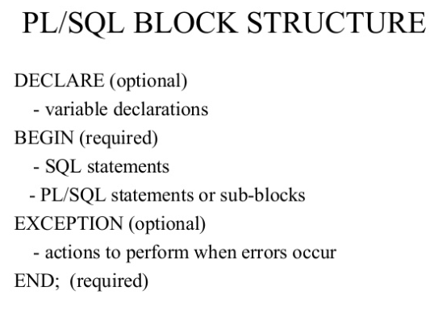
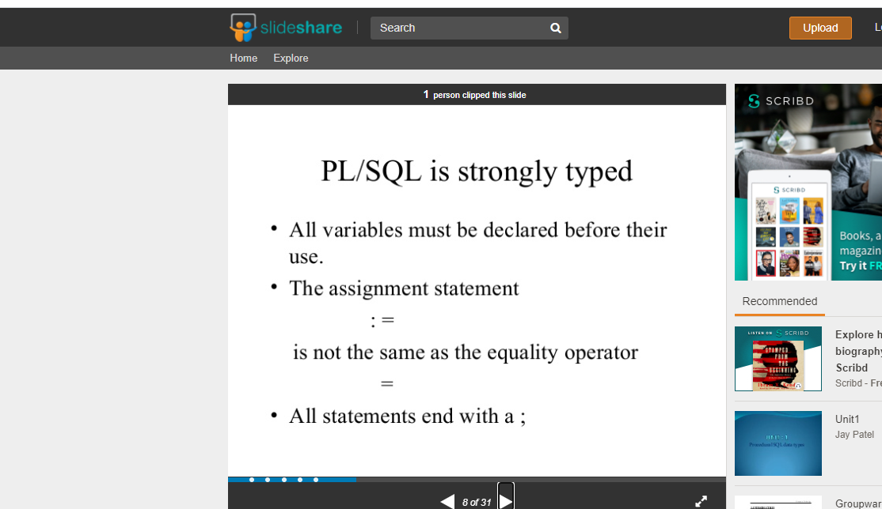

Slide 65
S.No | Sections & Description
1 | Declarations This section starts with the keyword DECLARE. It is an optional section and defines all variables, cursors, subprograms, and other elements to be used in the program.
2 | Executable Commands This section is enclosed between the keywords BEGIN and END and it is a mandatory section. It consists of the executable PL/SQL statements of the program. It should have at least one executable line of code, which may be just a NULL command to indicate that nothing should be executed.
3 | Exception Handling This section starts with the keyword EXCEPTION. This optional section contains exception(s) that handle errors in the program.
The end; line signals the end of the PL/SQL block. To run the code from the SQL command line, you may need to type / at the beginning of the first blank line after the last line of the code.

Slide 66
How to declare variable in PL/SQL??
Syntax
variable_name [CONSTANT] datatype [NOT NULL] [:= | DEFAULT initial_value]
Initializing Variables in PL/SQL
Evertime you declare a variable, PL/SQL defines a default value NULL to it.
If you want to initialize a variable with other value than NULL value, you can do so during the declaration, by using any one of the following methods.
The DEFAULT keyword
The assignment operator
DECLARE
a integer := 30;
b integer := 40;
c integer;
f real;
BEGIN
c := a + b;
dbms_output.put_line('Value of c: ' || c);
f := 100.0/3.0;
dbms_output.put_line('Value of f: ' || f);
END;
Output
Value of c: 70
Value of f: 33.333333333333333333
PL/SQL procedure successfully completed.

Slide 67
PL/SQL Constants
Syntax
constant_name CONSTANT datatype := VALUE;
Constant_name:it is the name of constant just like variable name. The constant word is a reserved word and its value does not change.
VALUE: it is a value which is assigned to a constant when it is declared. It can not be assigned later.
DECLARE
-- constant declaration
pi constant number := 3.141592654;
-- other declarations
radius number(5,2);
dia number(5,2);
circumference number(7, 2);
area number (10, 2);
BEGIN
-- processing
radius := 9.5;
dia := radius * 2;
circumference := 2.0 * pi * radius;
area := pi * radius * radius;
-- output
dbms_output.put_line('Radius: ' || radius);
dbms_output.put_line('Diameter: ' || dia);
dbms_output.put_line('Circumference: ' || circumference);
dbms_output.put_line('Area: ' || area);
END;
Output
Radius: 9.5
Diameter: 19
Circumference: 59.69
Area: 283.53
Pl/SQL procedure successfully completed.

Slide 68
PL/SQL if
Syntax: (IF-THEN statement)
IF condition
THEN
Statement: {It is executed when condition is true}
END IF;
Syntax: (IF-THEN-ELSE statement)
IF condition
THEN
{...statements to execute when condition is TRUE...}
ELSE
{...statements to execute when condition is FALSE...}
END IF;

Slide 69
Example of PL/SQL If Statement
DECLARE
a number(3) := 500;
BEGIN
-- check the boolean condition using if statement
IF( a < 20 ) THEN
-- if condition is true then print the following
dbms_output.put_line('a is less than 20 ' );
ELSE
dbms_output.put_line('a is not less than 20 ' );
END IF;
dbms_output.put_line('value of a is : ' || a);
END;
Output
a is not less than 20
value of a is : 500
PL/SQL procedure successfully completed.

Slide 70
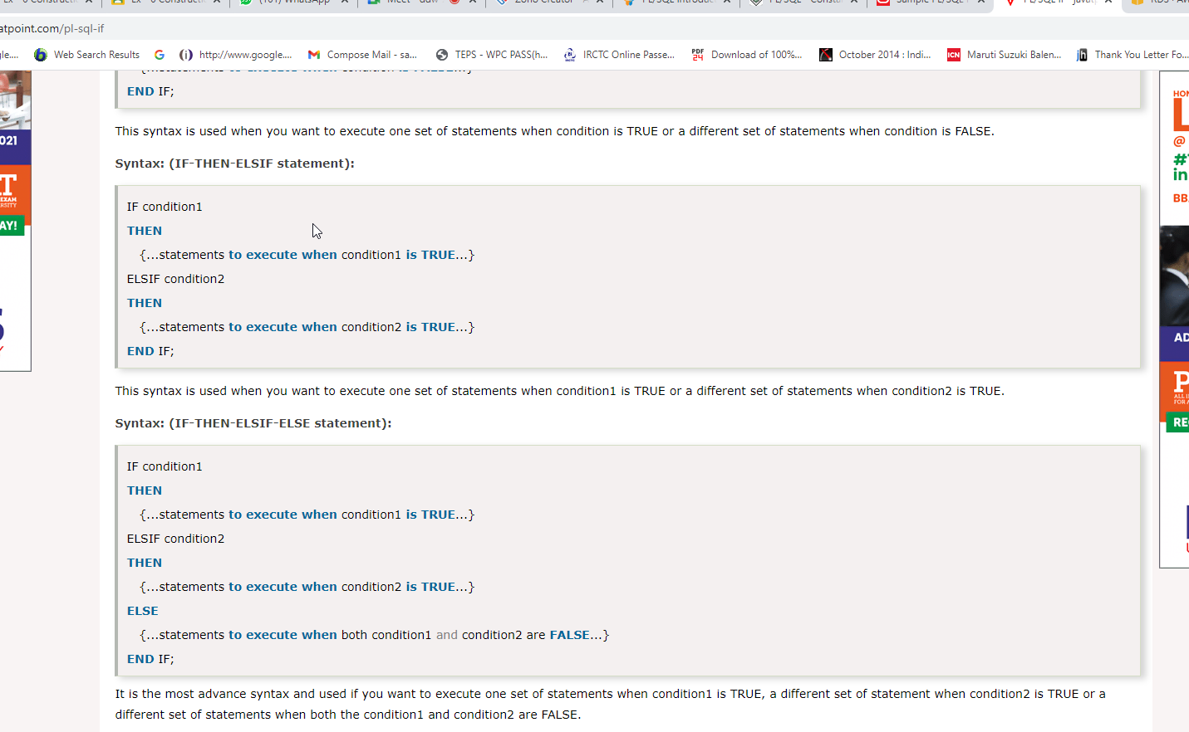
The syntax of an IF-THEN-ELSIF Statement in PL/SQL programming language is −
IF(boolean_expression 1)THEN
S1; -- Executes when the boolean expression 1 is true
ELSIF( boolean_expression 2) THEN
S2; -- Executes when the boolean expression 2 is true
ELSIF( boolean_expression 3) THEN
S3; -- Executes when the boolean expression 3 is true
ELSE
S4; -- executes when the none of the above condition is true
END IF;
This syntax is used when you want to execute one set of statements when condition1 is TRUE or a different set of statements when condition2 is TRUE.
It is the most advance syntax and used if you want to execute one set of statements when condition1 is TRUE, a different set of statement when condition2 is TRUE or a different set of statements when both the condition1 and condition2 are FALSE.

Slide 71
PL/SQL Control Structure
PL/SQL While Loop
Syntax
WHILE <condition>
LOOP statements;
END LOOP;
Output
1
2
3
4
5
6
7
8
9
10
DECLARE
i INTEGER := 1;
BEGIN
WHILE i <= 10 LOOP
DBMS_OUTPUT.PUT_LINE(i);
i := i+1;
END LOOP;
END;

Slide 72
PL/SQL While Loop
DECLARE
VAR1 NUMBER;
VAR2 NUMBER;
BEGIN
VAR1:=200;
VAR2:=1;
WHILE (VAR2<=10)
LOOP
DBMS_OUTPUT.PUT_LINE (VAR1*VAR2);
VAR2:=VAR2+1;
END LOOP;
END;

Slide 73
PL/SQL FOR Loop
Syntax
FOR counter IN initial_value .. final_value LOOP
LOOP statements;
END LOOP;
initial_value : Start integer value
final_value : End integer value
PL/SQL For Loop Example
BEGIN
FOR k IN 1..10 LOOP
-- note that k was not declared
DBMS_OUTPUT.PUT_LINE(k);
END LOOP;
END;
Output
1
2
3
4
5
6
7
8
9
10

Slide 74
PL/SQL For Loop Example
DECLARE
VAR1 NUMBER;
BEGIN
VAR1:=10;
FOR VAR2 IN 1..10
LOOP
DBMS_OUTPUT.PUT_LINE (VAR1*VAR2);
END LOOP;
END;
Output
10
20
30
40
50
60
70
80
90
100

Slide 75
PL/SQL For Loop REVERSE
DECLARE
VAR1 NUMBER;
BEGIN
VAR1:=10;
FOR VAR2 IN REVERSE 1..10
LOOP
DBMS_OUTPUT.PUT_LINE (VAR1*VAR2);
END LOOP;
END;
Output
100
90
80
70
60
50
40
30
20
10

Slide 76
PL/SQL Cursor
When an SQL statement is processed, Oracle creates a memory area known as context area.
A cursor is a pointer to this context area.
It contains all information needed for processing the statement.
In PL/SQL, the context area is controlled by Cursor.
A cursor contains information on a select statement and the rows of data accessed by it.
A cursor is used to referred to a program to fetch and process the rows returned by the SQL statement, one at a time.
There are two types of cursors
Implicit Cursors
Explicit Cursors

Slide 77
PL/SQL Implicit Cursors
The implicit cursors are automatically generated by Oracle while an SQL statement is executed, if you don't use an explicit cursor for the statement.
These are created by default to process the statements when DML statements like INSERT, UPDATE, DELETE etc. are executed.
Oracle provides some attributes known as Implicit cursor's attributes to check the status of DML operations.
Some of them are: %FOUND, %NOTFOUND, %ROWCOUNT and %ISOPEN.

Slide 78
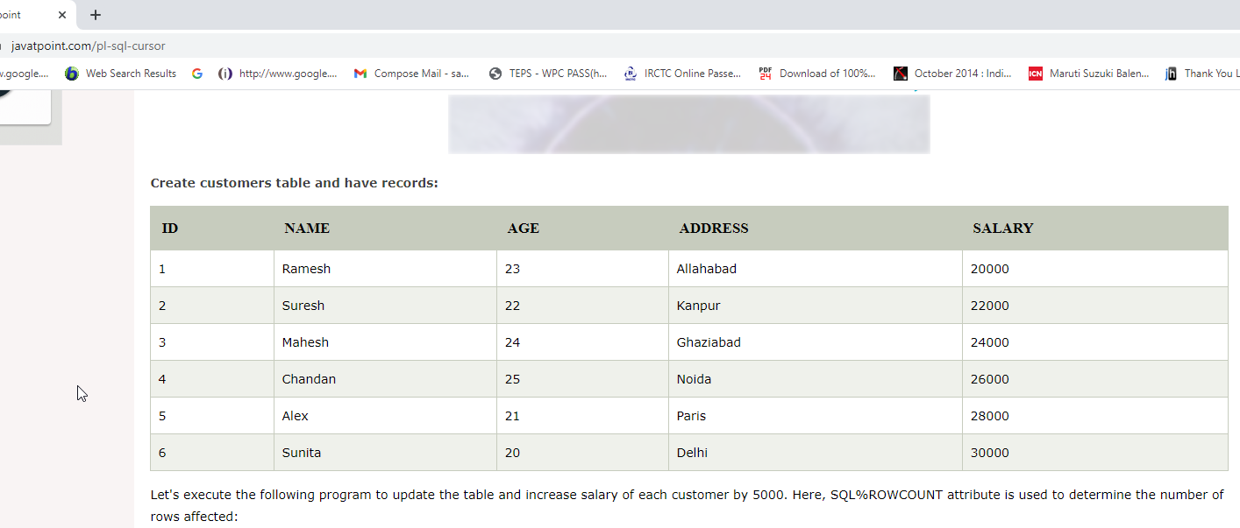
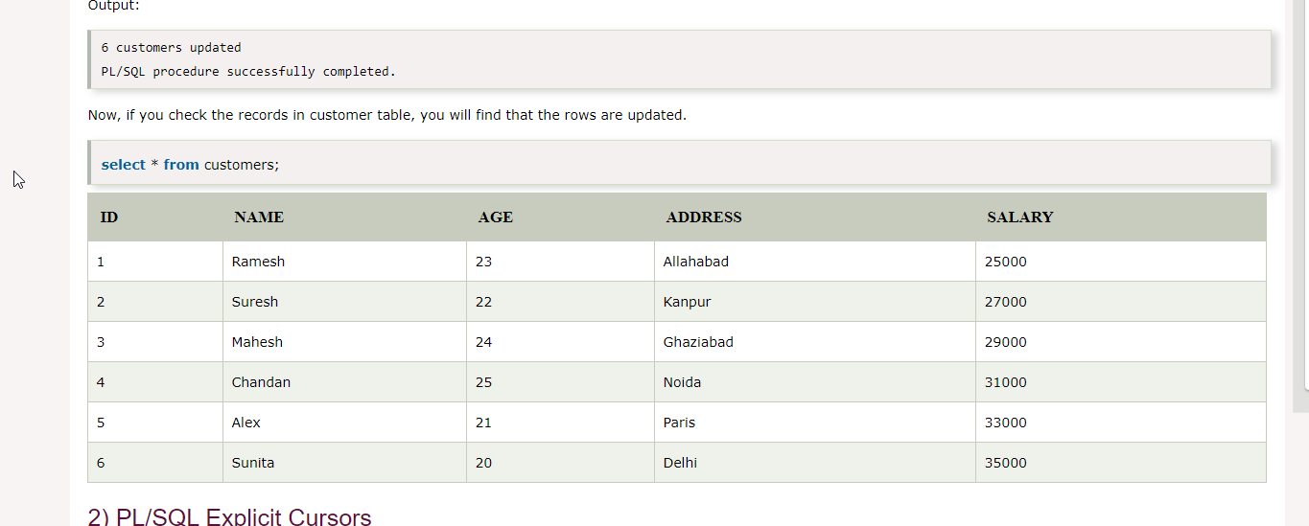
PL/SQL Implicit Cursor Example
To update the table and increase salary of each customer by 5000.
DECLARE
total_rows number(2);
BEGIN
UPDATE customers
SET salary = salary + 5000;
IF sql%notfound THEN
dbms_output.put_line('no customers updated');
ELSIF sql%found THEN
total_rows := sql%rowcount;
dbms_output.put_line( total_rows || ' customers updated ');
END IF;
END;
/
select * from customers;
Output
6 customers updated
PL/SQL procedure successfully completed.

Slide 79
PL/SQL Explicit Cursors
The Explicit cursors are defined by the programmers to gain more control over the context area.
These cursors should be defined in the declaration section of the PL/SQL block.
It is created on a SELECT statement which returns more than one row.
Syntax of explicit cursor
CURSOR cursor_name IS select_statement;
Steps
Declare the cursor to initialize in the memory.
Open the cursor to allocate memory.
Fetch the cursor to retrieve data.
Close the cursor to release allocated memory.

Slide 80
Declare the cursor
It defines the cursor with a name and the associated SELECT statement.
Syntax
CURSOR name IS
SELECT statement;
Open the cursor
It is used to allocate memory for the cursor and make it easy to fetch the rows returned by the SQL statements into it.
Syntax
OPEN cursor_name;
Fetch the cursor
It is used to access one row at a time. You can fetch rows from the above-opened cursor.
Syntax
FETCH cursor_name INTO variable_list;
Close the cursor
It is used to release the allocated memory. The following syntax is used to close the above-opened cursor.
Syntax
Close cursor_name;

Slide 81
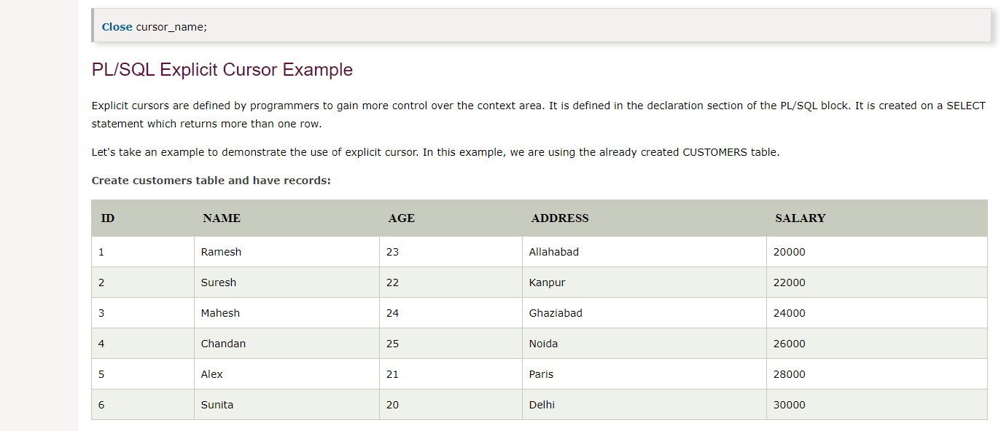
PL/SQL Explicit Cursor Example
DECLARE
c_id customers.id%type;
c_name customers.name%type;
c_addr customers.address%type;
CURSOR c_customers is
SELECT id, name, address FROM customers;
BEGIN
OPEN c_customers;
LOOP
FETCH c_customers into c_id, c_name, c_addr;
EXIT WHEN c_customers%notfound;
dbms_output.put_line(c_id || ' ' || c_name || ' ' || c_addr);
END LOOP;
CLOSE c_customers;
END;
/
Explicit cursors are defined by programmers to gain more control over the context area.
It is defined in the declaration section of the PL/SQL block. It is created on a SELECT statement which returns more than one row.
Output
1 Ramesh Allahabad
2 Suresh Kanpur
3 Mahesh Ghaziabad
4 Chandan Noida
5 Alex Paris
6 Sunita Delhi
PL/SQL procedure successfully completed.

Slide 82
Brain Work!!!
Why to use Cursor?
When to use Cursor?
OLTP??

Slide 83
Triggers
Triggers are stored programs, which are automatically executed or fired when some events occur. Triggers are, in fact, written to be executed in response to any of the following events
A database manipulation (DML) statement (DELETE, INSERT, or UPDATE)
A database definition (DDL) statement (CREATE, ALTER, or DROP).
A database operation (SERVERERROR, LOGON, LOGOFF, STARTUP, or SHUTDOWN).
Triggers can be defined on the table, view, schema, or database with which the event is associated.

Slide 84
Benefits of Triggers
Triggers can be written for the following purposes
Generating some derived column values automatically
Enforcing referential integrity
Event logging and storing information on table access
Auditing
Synchronous replication of tables
Imposing security authorizations
Preventing invalid transactions

Slide 85
Creating Triggers
CREATE [OR REPLACE] TRIGGER trigger_name − Creates or replaces an existing trigger with the trigger_name.
{BEFORE | AFTER | INSTEAD OF} − This specifies when the trigger will be executed. The INSTEAD OF clause is used for creating trigger on a view.
{INSERT [OR] | UPDATE [OR] | DELETE} − This specifies the DML operation.
[OF col_name] − This specifies the column name that will be updated.
[ON table_name] − This specifies the name of the table associated with the trigger.
[REFERENCING OLD AS o NEW AS n] − This allows you to refer new and old values for various DML statements, such as INSERT, UPDATE, and DELETE.
[FOR EACH ROW] − This specifies a row-level trigger, i.e., the trigger will be executed for each row being affected.
Otherwise the trigger will execute just once when the SQL statement is executed, which is called a table level trigger.
WHEN (condition) − This provides a condition for rows for which the trigger would fire. This clause is valid only for row-level triggers.
Syntax
CREATE [OR REPLACE ] TRIGGER trigger_name
{BEFORE | AFTER | INSTEAD OF }
{INSERT [OR] | UPDATE [OR] | DELETE}
[OF col_name]
ON table_name
[REFERENCING OLD AS o NEW AS n]
[FOR EACH ROW]
WHEN (condition)
DECLARE
Declaration-statements
BEGIN
Executable-statements
EXCEPTION
Exception-handling-statements
END;

Slide 86
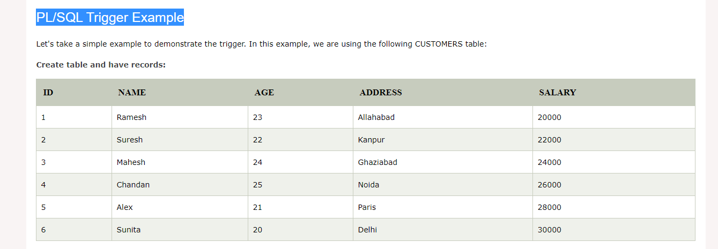
PL/SQL Trigger Example
Write a program to create a row level trigger for the CUSTOMERS table that would fire for INSERT or UPDATE or DELETE operations performed on the CUSTOMERS table. This trigger will display the salary difference between the old values and new values
Create trigger
CREATE OR REPLACE TRIGGER display_salary_changes
BEFORE DELETE OR INSERT OR UPDATE ON customers
FOR EACH ROW
WHEN (NEW.ID > 0)
DECLARE
sal_diff number;
BEGIN
sal_diff := :NEW.salary - :OLD.salary;
dbms_output.put_line('Old salary: ' || :OLD.salary);
dbms_output.put_line('New salary: ' || :NEW.salary);
dbms_output.put_line('Salary difference: ' || sal_diff);
END;
/
Trigger created

Slide 87
Check the salary difference by procedure
Use the following code to get the old salary, new salary and salary difference after the trigger created.
Output
Old salary: 20000
New salary: 25000
Salary difference: 5000
Old salary: 22000
New salary: 27000
Salary difference: 5000
Old salary: 24000
New salary: 29000
Salary difference: 5000
Old salary: 26000
New salary: 31000
Salary difference: 5000
Old salary: 28000
New salary: 33000
Salary difference: 5000
Old salary: 30000
New salary: 35000
Salary difference: 5000
6 customers updated
DECLARE
total_rows number(2);
BEGIN
UPDATE customers
SET salary = salary + 5000;
IF sql%notfound THEN
dbms_output.put_line('no customers updated');
ELSIF sql%found THEN
total_rows := sql%rowcount;
dbms_output.put_line( total_rows || ' customers updated ');
END IF;
END;
/

Slide 88
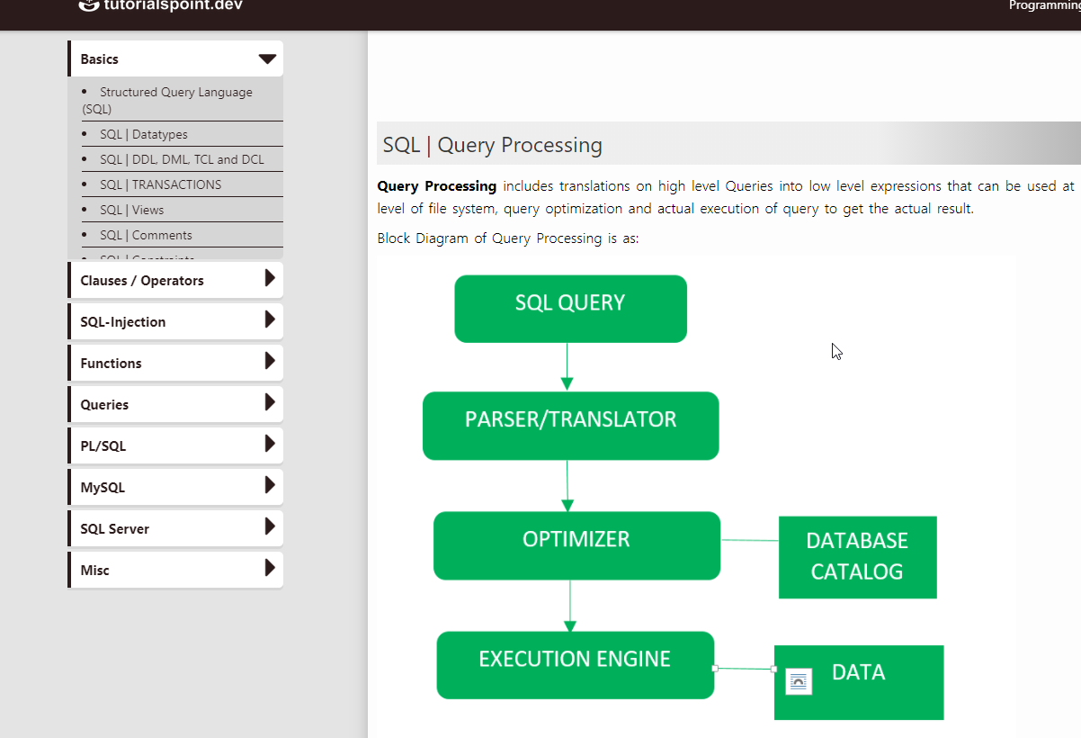
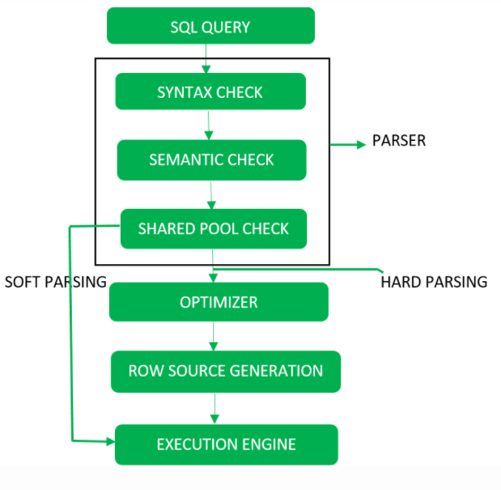
Query Processing
Query Processing includes translations on high level Queries into low level expressions that can be used at physical level of file system, query optimization and actual execution of query to get the actual result.
Block Diagram of Query Processing Detailed DiagramQuery Processing

Slide 89
Step-1
Parser: During parse call, the database performs the following checks- Syntax check, Semantic check and Shared pool check, after converting the query into relational algebra.
Parser performs the following
Syntax check – concludes SQL syntactic validity.
SELECT * FROM employee;
Semantic check – determines whether the statement is meaningful or not. Example: query contains a tablename which does not exist is checked by this check.
Shared Pool check – Every query possess a hash code during its execution. So, this check determines existence of written hash code in shared pool if code exists in shared pool then database will not take additional steps for optimization and execution.

Slide 90
Hard Parse and Soft Parse
If there is a fresh query and its hash code does not exist in shared pool then that query has to pass through from the additional steps known as hard parsing
If hash code exists then query does not passes through additional steps. It just passes directly to execution engine. This is known as soft parsing.
Step-2 Optimizer
During optimization stage, database must perform a hard parse at least for one unique DML statement and perform optimization during this parse. This database never optimizes DDL unless it includes a DML component such as subquery that require optimization.
It is a process in which multiple query execution plan for satisfying a query are examined and most efficient query plan is satisfied for execution.
Database catalog stores the execution plans and then optimizer passes the lowest cost plan for execution.

Slide 91
Row Source Generation
The Row Source Generation is a software that receives a optimal execution plan from the optimizer and produces an iterative execution plan that is usable by the rest of the database.
The iterative plan is the binary program that when executes by the sql engine produces the result set.
Step-3 Execution Engine
Finally runs the query and display the required result.

Slide 92
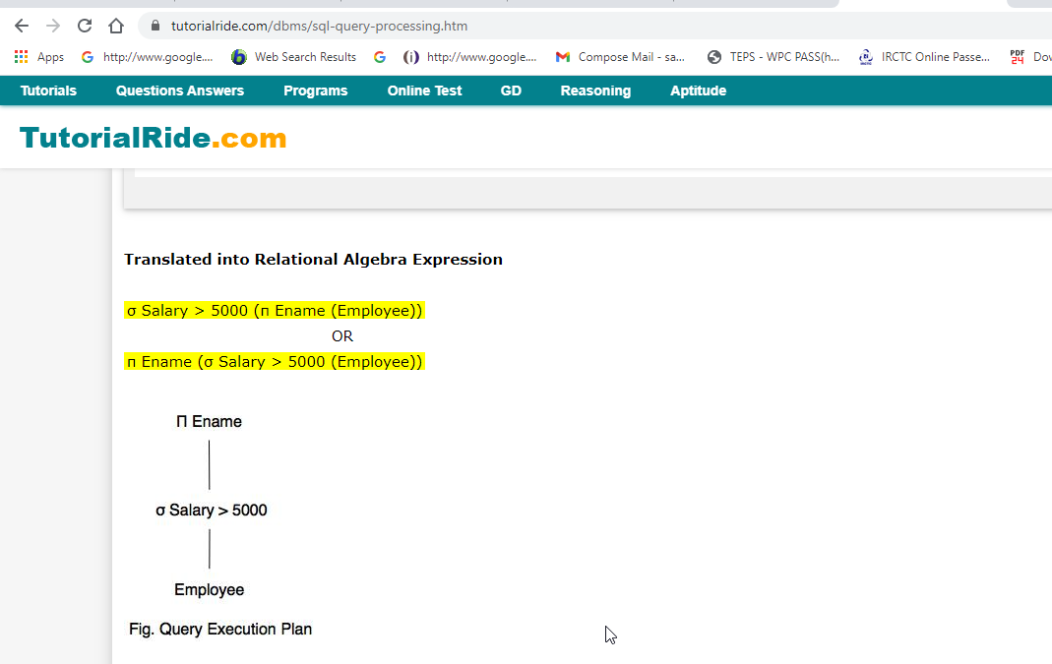
Translating SQL Queries into Relational Algebra
SELECT Ename FROM Employee WHERE Salary > 5000;

Slide 93
PL/SQL - Procedures
A subprogram is a program unit/module that performs a particular task. These subprograms are combined to form larger programs.
A subprogram can be invoked by another subprogram or program which is called the calling program.
A subprogram can be created
At the schema level
Inside a package
Inside a PL/SQL block
PL/SQL subprograms are named PL/SQL blocks that can be invoked with a set of parameters. PL/SQL provides two kinds of subprograms
Functions − These subprograms return a single value; mainly used to compute and return a value.
Procedures − These subprograms do not return a value directly; mainly used to perform an action.

Slide 94
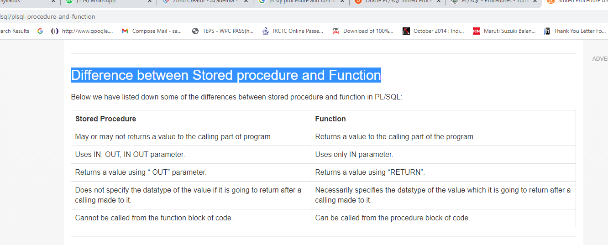
Difference between Stored procedure and Function

Slide 95
Syntax for creating Stored Procedure
CREATE OR REPLACE PROCEDURE <procedure_name> (<variable_name>IN/OUT/IN OUT <datatype>,
<variable_name>IN/OUT/IN OUT <datatype>,...) IS/AS
variable/constant declaration;
BEGIN
-- PL/SQL subprogram body;
EXCEPTION
-- Exception Handling block ;
END <procedure_name>;
procedure_name - Name of the procedure
variable_name - Name of the variable used in the stored procedure.
CREATE or REPLACE PROCEDURE is a keyword used for specifying the name of the procedure to be created.
BEGIN, EXCEPTION and END are keywords used to indicate different sections of the procedure being created.
IN/OUT/IN OUT are parameter modes.
IN mode refers to READ ONLY mode which is used for a variable by which it will accept the value from the user. It is the default parameter mode.
OUT mode refers to WRITE ONLY mode which is used for a variable that will return the value to the user.
IN OUT mode refers to READ AND WRITE mode which is used for a variable that will either accept a value from the user or it will return the value to the user.
At the end, <procedure_name> is optional to write, you can simply use END statement to end the procedure definition.

Slide 96


Executing Standalone Procedure
Standalone Procedure
Executing a Standalone Procedure
A standalone procedure can be called in two ways
Using the EXECUTE keyword
Calling the name of the procedure from a PL/SQL block
Standalone Procedure Execution

Slide 97

Addition of two numbers
set serveroutput on;
DECLARE
x number;
y number;
BEGIN
x := &x;
y := &y;
Sum(x,y);
END;
/
set serveroutput on;
CREATE OR REPLACE PROCEDURE Sum(a IN number, b IN number) IS
c number;
BEGIN
c := a+b;
dbms_output.put_line('Sum of two nos= '|| c);
END Sum;
/
Procedure created

Slide 98

Square of number

Slide 99

PL/SQL Drop Procedure

Slide 100

Syntax for creating Functions
function_name is for defining function's name and variable_name is the variable name for variable used in the function.
CREATE or REPLACE FUNCTION is a keyword used for specifying the name of the function to be created.
IN mode refers to READ ONLY mode which is used for a variable by which it will accept the value from the user. It is the default parameter mode.
RETURN is a keyword followed by a datatype specifying the datatype of a value that the function will return.

Slide 101


Slide 102



Functions Example
Customers table
Function
Calling a Function
Output

Slide 103

Maximum of two numbers using functions

Slide 104

PL/SQL Recursive Functions
Using Predefined Input
Using User defined input

Slide 105


Slide 106


